Slide 1
Grief, Compassion
Giving our kids the tools they need
Barbie has a great passion for youth mental health. She went back to school for her psychology and sociology degrees, became a Youth Mental Health First Aid trainer, Cope2Thrive Trainer, Life Coach, and has been the Executive Director of NAMI Eastside for two years. She is also the parent of a 17 year old son, and guardian of a 17 year old daughter.

Slide 2
Celebrating 21 years working to improve the mental health delivery system and the quality of life for those impacted by mental health conditions through advocacy, community awareness, education and support.

Slide 3
Youth Ambassador Program
https://nami-eastside.org/youth/
You are the expert on YOU!
Student Driven
Empowering student voices
Opportunities: Projects, Scholarships, Internships
Advocacy
Youth Mental Health Conference
Free to join
Middle & High School Students
Cope2Thrive
Teen Mental Health First Aid
Start a mental health club at your school!

Slide 4
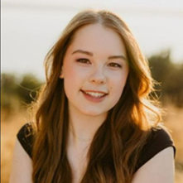
Allie Clark
Allie Clark is a Senior at Issaquah High School.
2022 Mental Health Hero nominee
A founding Youth Ambassador, and part of the inspiration for this program’s creation. Youth spokesperson and first official intern.
She works tirelessly to promote empathy and end the stigma surrounding mental health.
She has had her own struggles with anxiety, and can now use that experience to fuel her efforts for mental health advocacy.
She also recently received her certification for Teen Mental Health First Aid and Cope2Thrive.

Slide 5
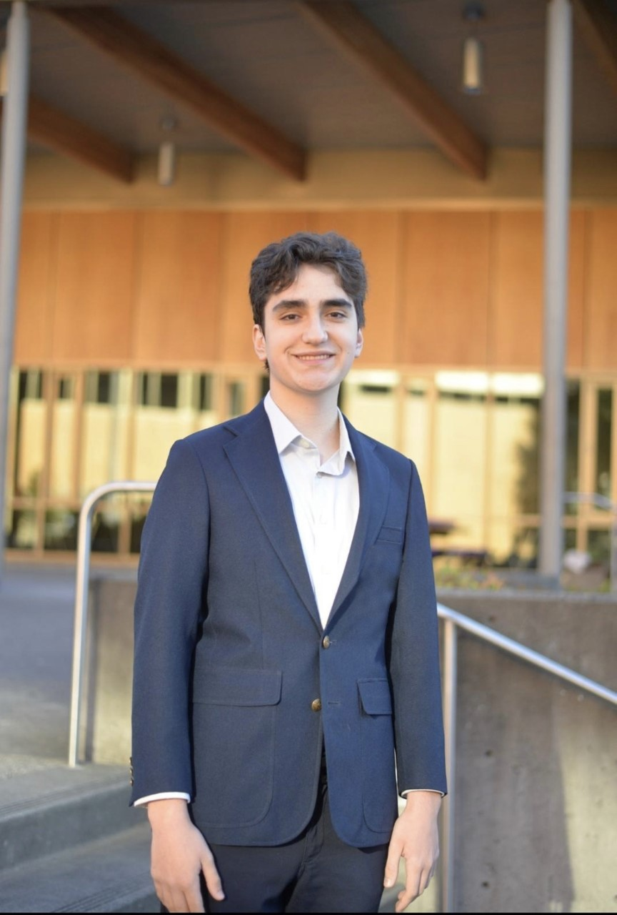
Alec Yildirim
A Senior at Issaquah High School.
Alec is hoping to address, validate, and offer unconditional support for all of his peers who may be struggling.
Involved with Psychology Club, and has a passion for learning things intuitively.

Slide 6
Special thanks to Taanvi
13 year old 8th grader at Kenmore Middle School
Youth Ambassador
Mental Health Hero Nominee
Best selling author
NAMI Eastside Youth Ambassador!

Slide 7
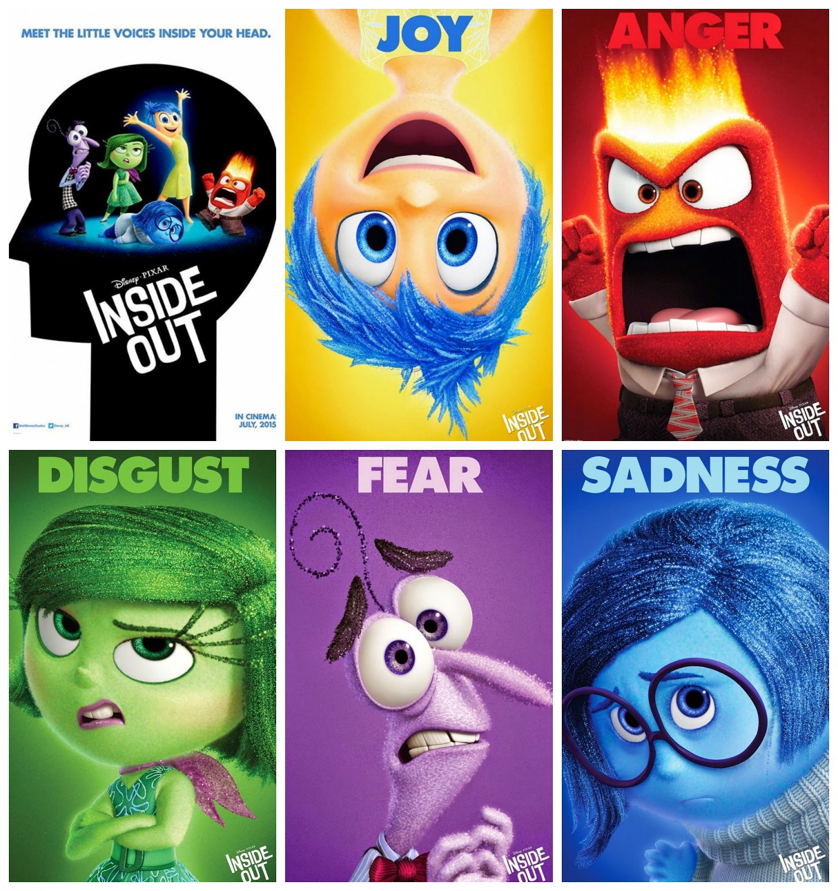

Slide 8
https://www.youtube.com/watch?v=yRUAzGQ3nSY

Slide 9
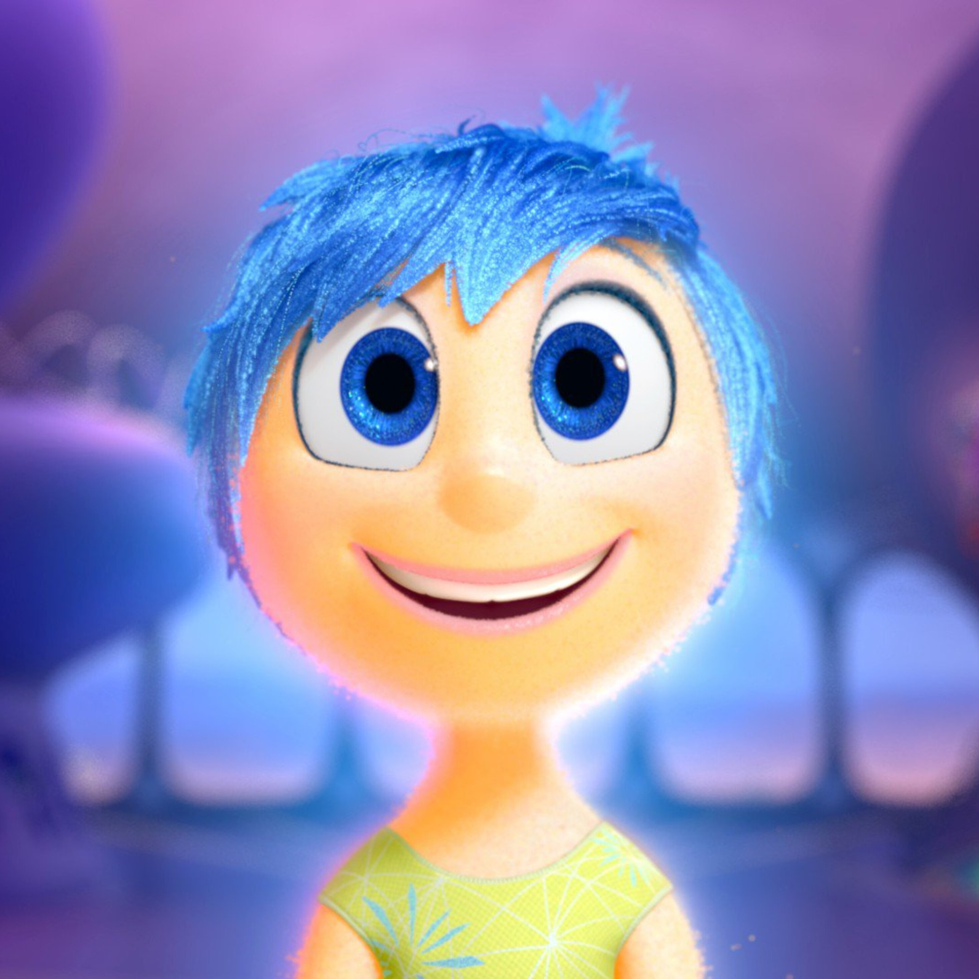
JOY
Joy's goal has always been to make sure Riley stays joyful. She is lighthearted, optimistic, and determined to find the fun in every situation. Joy sees challenges in Riley's life as opportunities and the less happy moments as hiccups on the way back to something great. As long as Riley is happy, so is Joy.

Slide 10
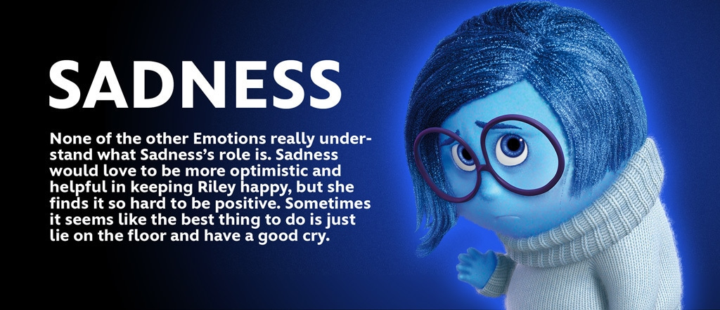

Slide 11
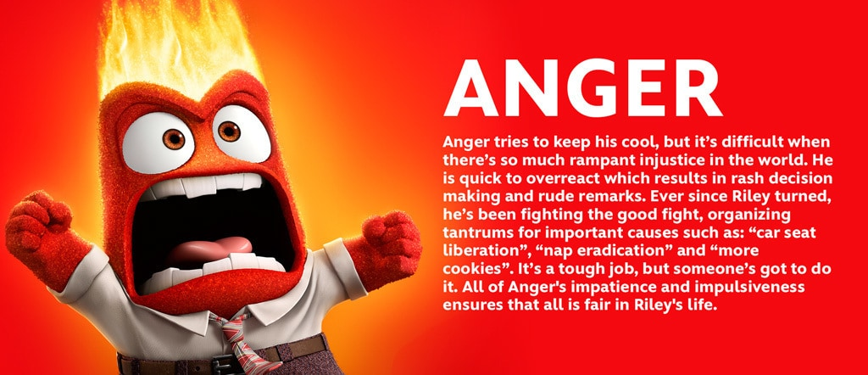

Slide 12
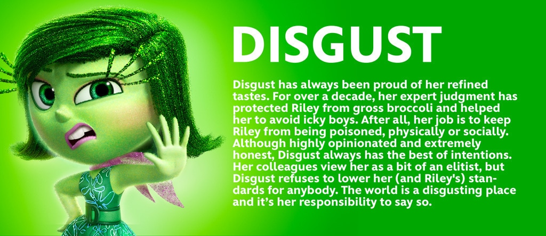

Slide 14
What is “Normal”??
All emotions are normal! Fear, Disgust, Anger, Sadness & Joy
You are not alone! This is “normal”
We have ‘collective grief’
Your parents, teachers, school staff are feeling it too

Slide 15
How do emotions show up?
Events that trigger…
What triggers JOY?
What triggers SADNESS?
What triggers DISGUST?
What triggers ANGER?
What triggers FEAR?
Notes:
Situations: Give situations and have kids shout the answers I got an A on my test! A friend said I looked really nice today. I didn’t get to sit by my friends at lunch I thought I did a good job on my project, but I got a bad grade.

Slide 16
What to look for
Signs & Symptoms
Physical
Behavior
Emotional
Social
When to be concerned (about yourself or a friend)
How long has this been going on? Over two weeks?
It is affecting school work, family connections, friend groups
You feel like you can’t change it or it will never get better
Notes:
Situations

Slide 17
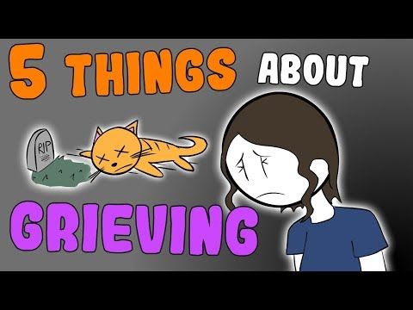
Grief & Loss
5 things about Grief nobody tells you
http://www.youtube.com/watch?v=8pT6LQ-mZ3k

Slide 18
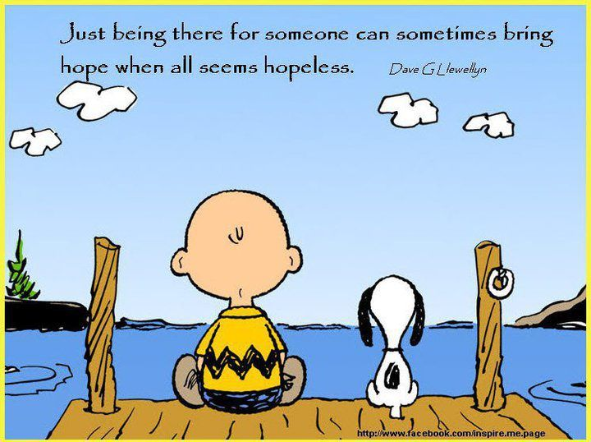
Grief & Loss
Healing is not linear
Struggle is not always visible
It’s okay to be curious
Ask for what you need
You don’t need to have the answers, just be there
How a trusted adult can help you

Slide 19
https://www.youtube.com/watch?v=o-7c74-pUlk

Slide 20
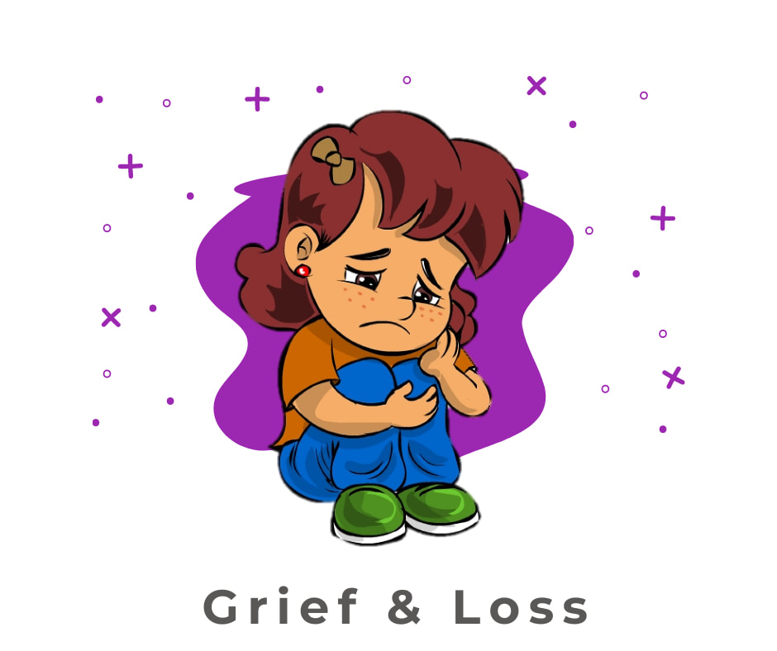
Our own experiences
Losing a pet
Losing a family member
Losing a classmate, peer or adult
Expected losses vs. Unexpected losses
These feel like they are under a magnifying glass

Slide 21
How we may respond to grief
Behavior changes Outbursts, feeling out of control, eating patterns, sleep changes, grades, social withdrawl…
Unfounded fears Avoiding situations, seeing risk in everything
Survivor guilt Why them and not me? Why didn’t I, why did I?
“Bottle it up” Keeping it inside, pretending you are okay
May trigger certain disorders (anxiety, depression)

Slide 22
How to start a conversation
What is on your mind? Talking to friends can help. Share empathy & compassion.
I have noticed…
I am feeling concerned…
I feel this way, do you ever feel this way?
How can I help?
I don’t know how to make this better, but I know who can…let’s get help.

Slide 23
How to share your feelings
I am feeling ______
Identify a trusted adult
Use your resources (back of your ID)
Say what you really need

Slide 24
How to manage your emotions
Outlets: Crying is a-ok! Be creative – draw, dance, sing, write Burn it off with exercise
Use coping skills
Visualize a place where you felt happy!
Talk to someone!

Slide 25
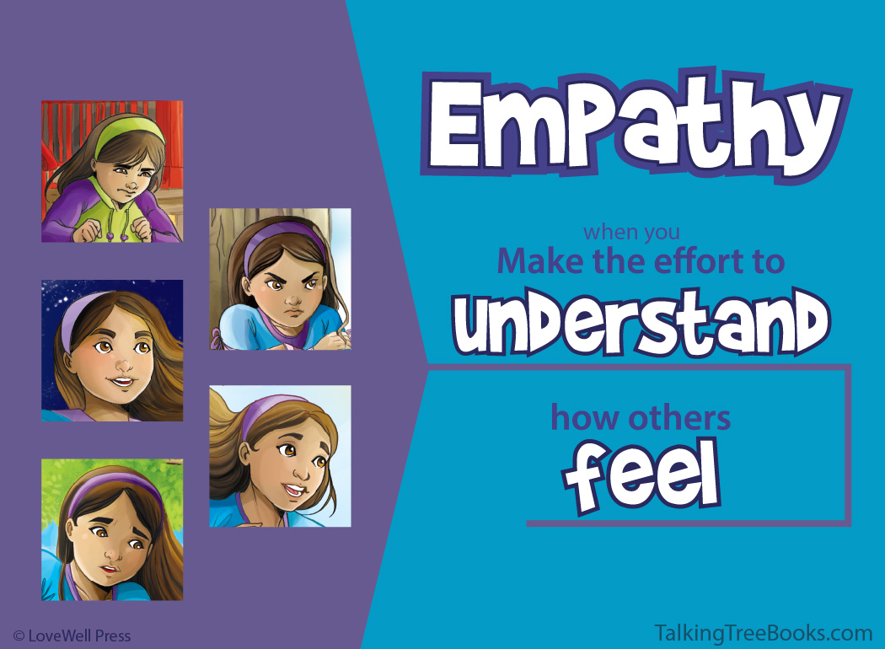

Slide 26
Some Common Symptoms Following a Traumatic Experience
Emotional
Mental
Behavioral
Physical
Feeling Alone
Feeling Afraid
Anger and Frustration
Mood Swings
Difficulty Sleeping
Feeling Sad
Feeling Hopeless
Loss of Concentration
Disorientation and Confusion
Memory Loss
Obsessive Thoughts
Distractibility
Withdrawal from Others
Aggression
Crying
Arguing with Loved ones
Increased Sleeping
Change in Appetite
Aches and Pains
Fatigue/ Tired
Nausea/ Vomiting
Shaking
Headaches
Numbness/ Tingling

Slide 27
Exercise
Emotional Symptom:
Feeling Alone
Is the symptom still present? If no, how long did it take to go away? How did you cope and overcome it? If still present, how do you cope with the symptom now?
Yes. I cope with feeling alone by calling a friend or putting on a comforting show.

Slide 28
Learn Coping Skills
Coping Skills

Slide 29
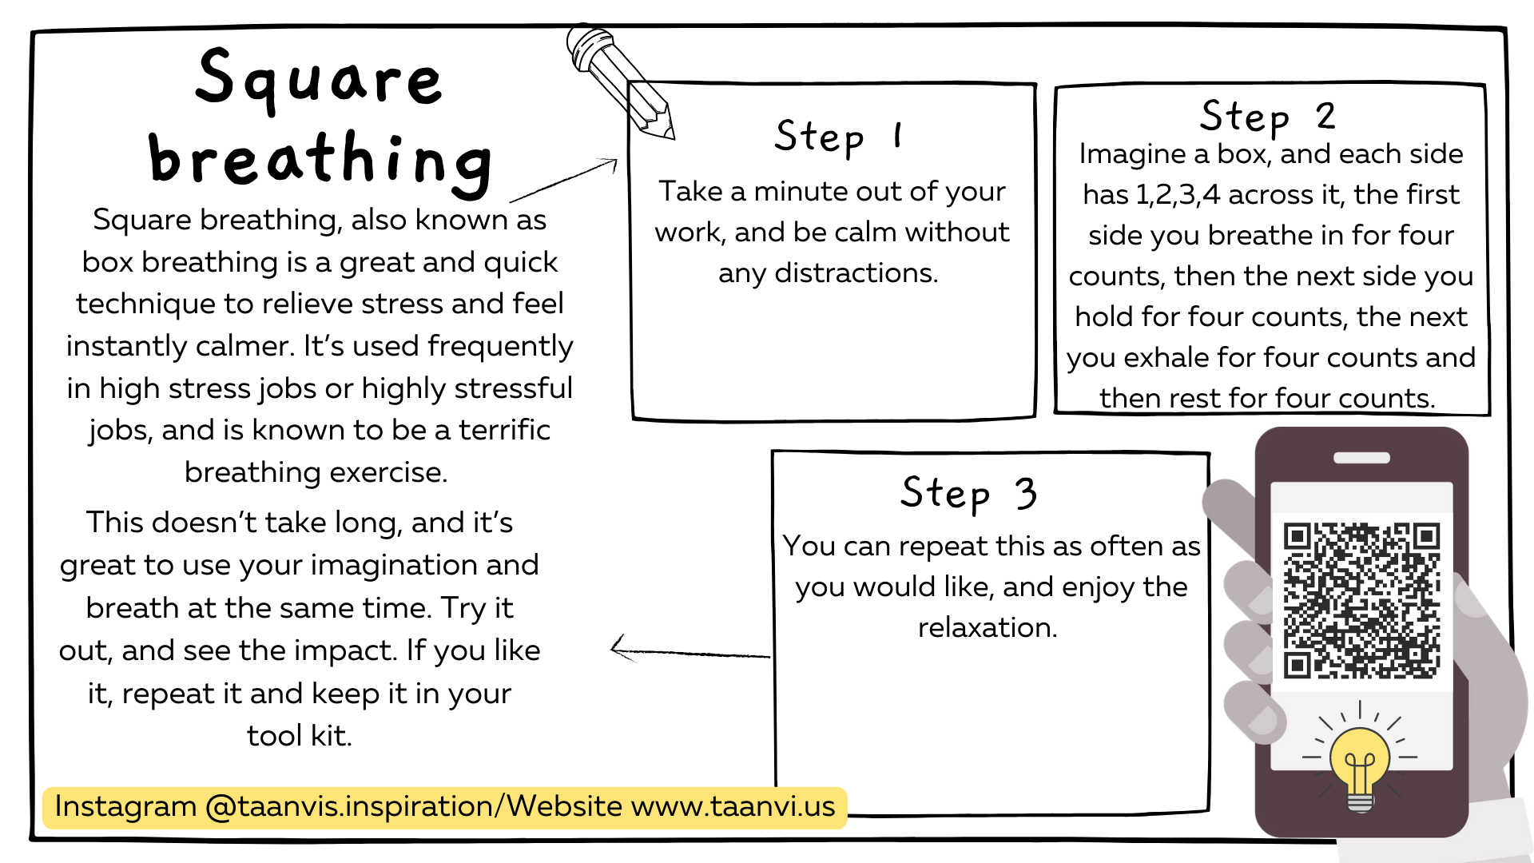
Learn Coping Skills
Coping Skills

Slide 30
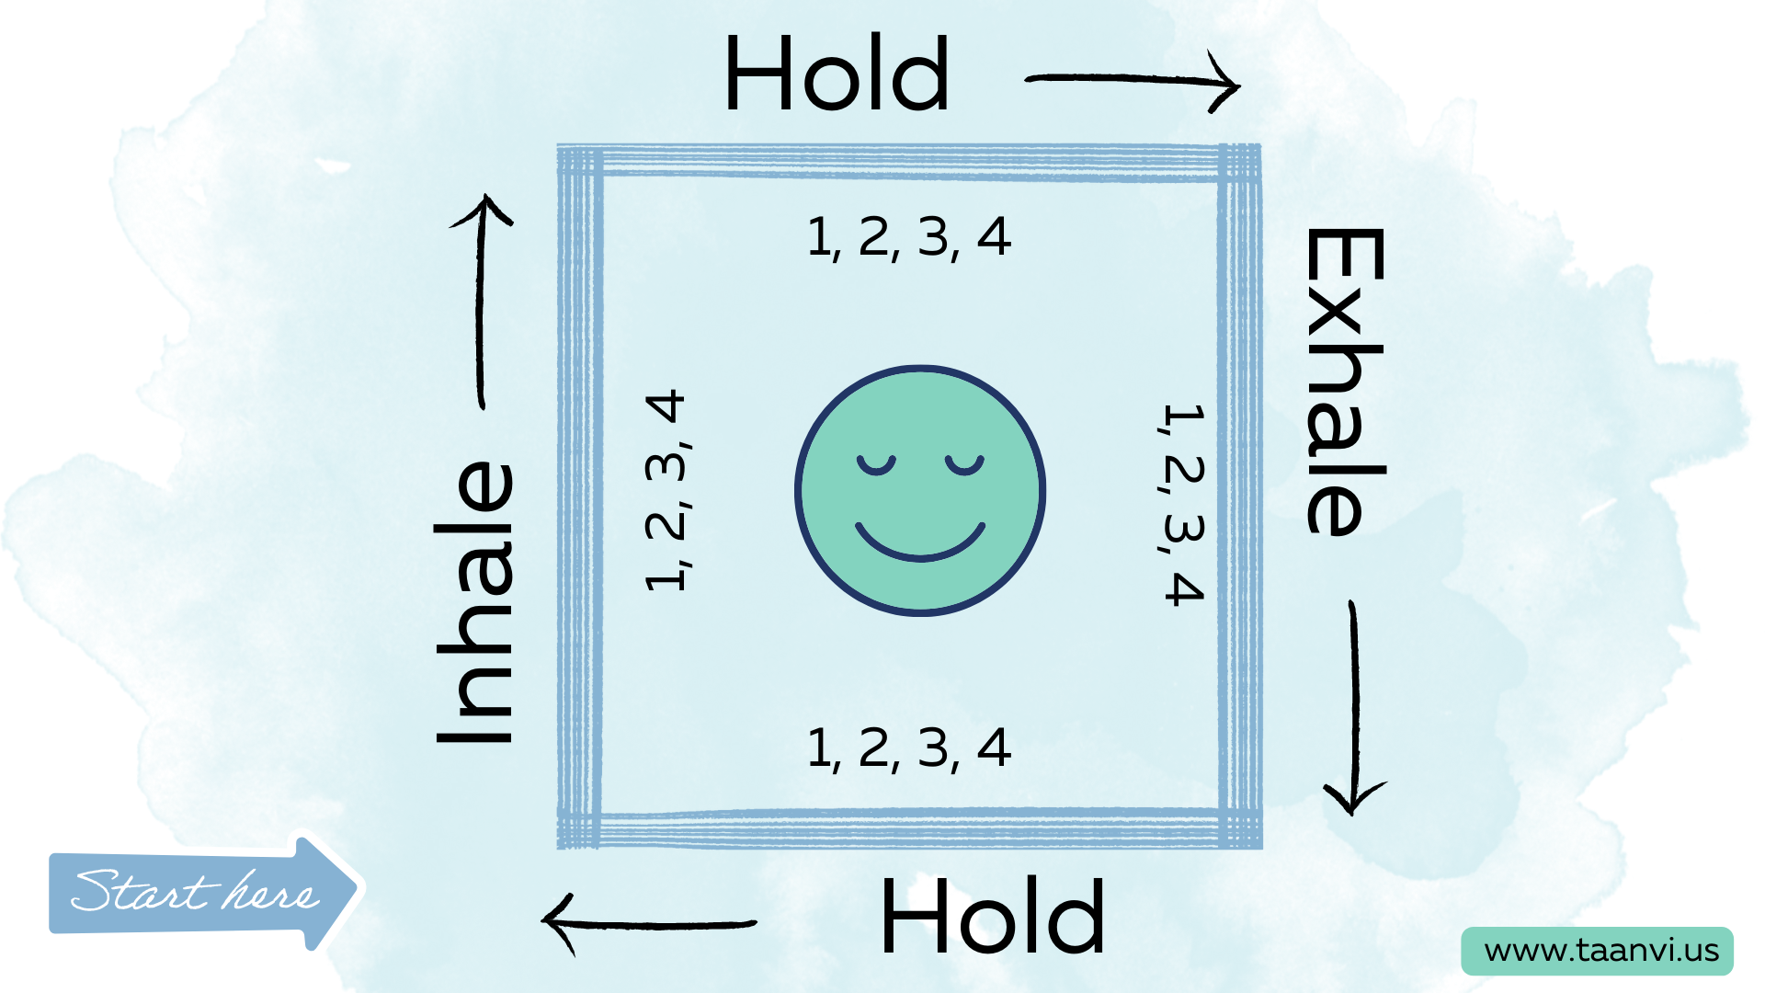
Learn Coping Skills
Coping Skills

Slide 31
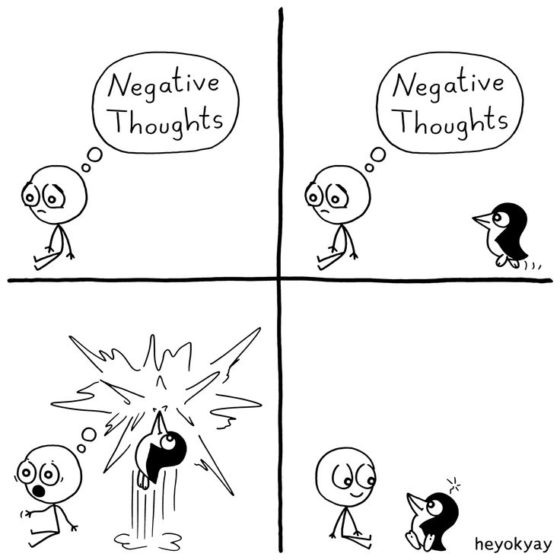
Reframe
CBT: Thinking-Feeling-Behaving
Change your thoughts = Change the outcome

Slide 32
Picture someone you have lost
What do you wish someone had said or would say to you?

Slide 33
Where to turn for
Help
Teen Link
Parents!
Mental Health Clubs
NAMI Eastside Youth Ambassador Team
Therapy (Grief counseling)
School counselors, teachers, principal – identify your person
Aunts, uncles, cousins, grandparents
Friend’s parents or older siblings

Slide 34
Where to turn for
Help
Teen Link
Parents!
Mental Health Clubs
NAMI Eastside Youth Ambassador Team
Therapy (Grief counseling)
School counselors, teachers, principal – identify your person
Aunts, uncles, cousins, grandparents
Friend’s parents or older siblings

Slide 36
What’s Next?
Who is your trusted adult? Don’t know? Let’s find you one!
Fill out your questionnaire
Start conversations
Follow us Instagram! NAMIEastside_Youth

Slide 37
What’s Next?
Who is your trusted adult? Don’t know? Let’s find you one!
Fill out your questionnaire
Start conversations
Address misconceptions: Grief is forever, teens don’t really experience it, stats on grief.
Follow us Instagram! NAMIEastside_Youth

